Slide 1
TAK Server - QUIC Protocol

Slide 2
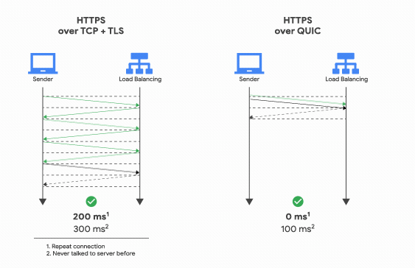
TAK Server - QUIC Protocol
QUIC (Quick UDP Internet Connection) is a general-purpose transport layer network protocol.
It includes a built-in encryption based on TLS, which provides secure communication between the endpoints, which makes it harder for third parties to intercept and manipulate the internet traffic.

Slide 3
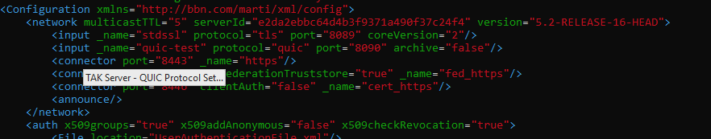
TAK Server - QUIC Protocol Setup
Open a terminal that is connected to your TAK Server and open the CoreConfig file with a text editor:
vim /opt/tak/CoreConfig.xml
Add the following line within the network body:
<input _name=“quic-test” protocol=“quic” port=“8090” archive=“false”/>
It should look like the following:

Slide 4
TAK Server - QUIC Protocol Setup
Configure the firewall by running the following:
List the current networks:
sudo firewall-cmd --list-all
Add the needed port:
sudo firewall-cmd --zone=public --add-port 8090/udp --permanent
Reload the firewall
sudo firewall-cmd --reload
Double check to ensure it was added properly:
sudo firewall-cmd --list-all

Slide 5
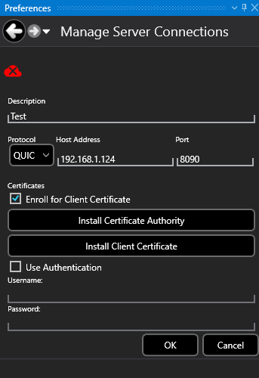
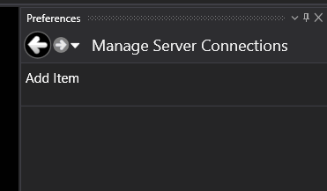

TAK Server - QUIC Protocol - Connecting
Start up your TAK device, I will be using WinTAK:
Open the network preferences and navigate to the server connection panel:
Select “Add Item”
Fill in the following information:
Description: Name the server connection
Connection:
Protocol: QUIC
Host Address: Server IP Address
Port: 8090
Certificates:
If you have auto enrollment setup:
Import the CA of the server.
Import both the CA and the client certificate
Select “OK” and enter in the credentials for the user when prompted.
You will have successfully connected when the cloud icon is green.

